Slide 1

CHAPTER 6
SET THEORY
Copyright © Cengage Learning. All rights reserved.

Slide 2
SECTION 6.4
Boolean Algebras, Russell’s Paradox, and the Halting Problem
Copyright © Cengage Learning. All rights reserved.

Slide 3
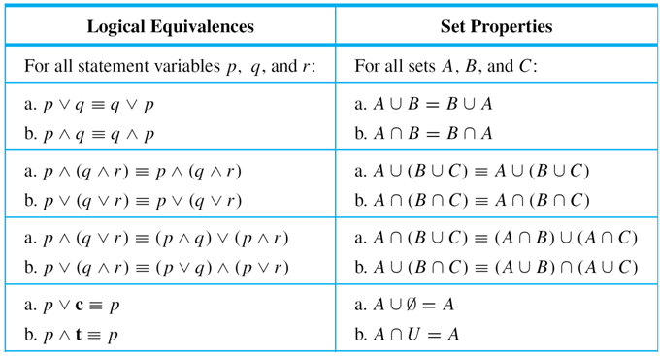
Boolean Algebras, Russell’s Paradox, and the Halting Problem
Table 6.4.1 summarizes the main features of the logical equivalences from Theorem 2.1.1 and the set properties from Theorem 6.2.2. Notice how similar the entries in the two columns are.
Table 6.4.1

Slide 4
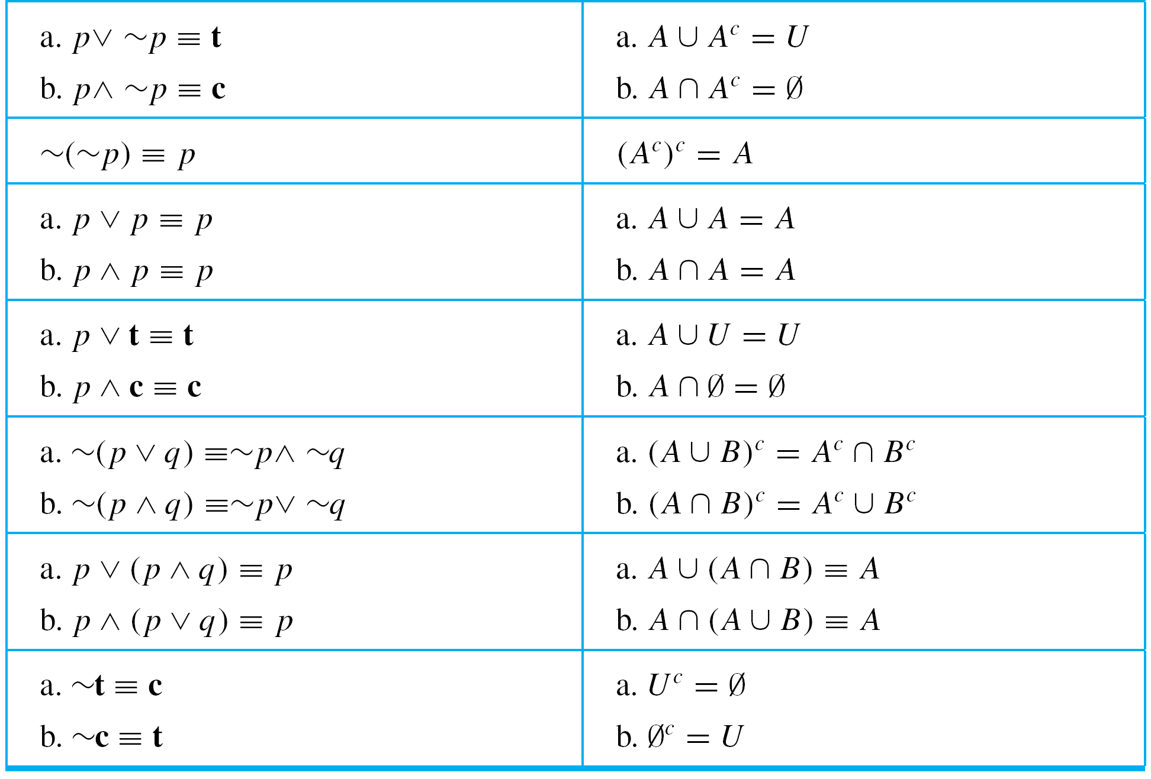
Boolean Algebras, Russell’s Paradox, and the Halting Problem
Table 6.4.1 (continued)

Slide 5
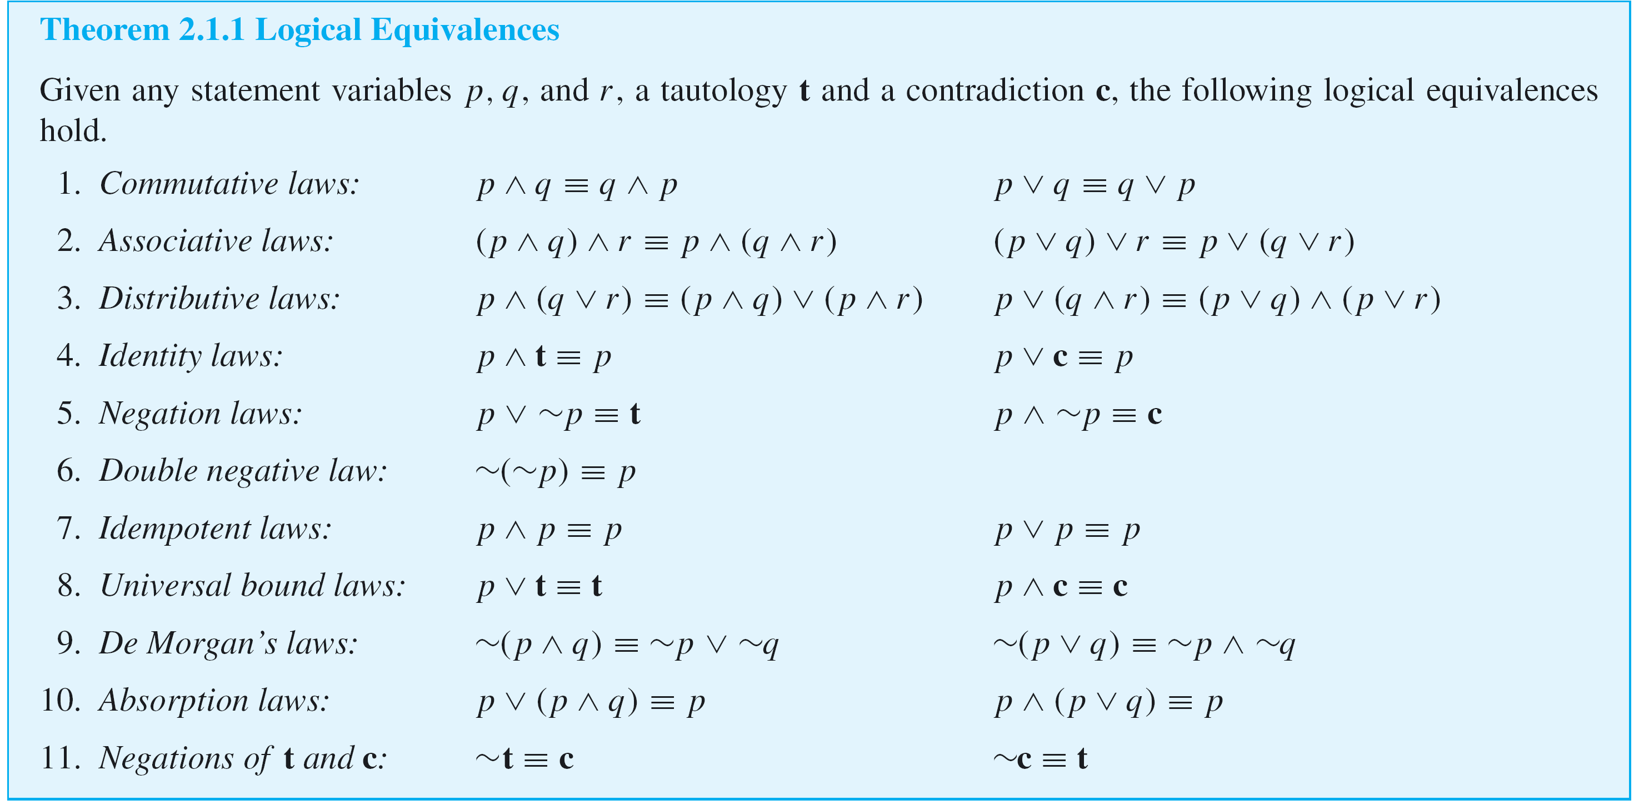
Boolean Algebras, Russell’s Paradox, and the Halting Problem

Slide 6
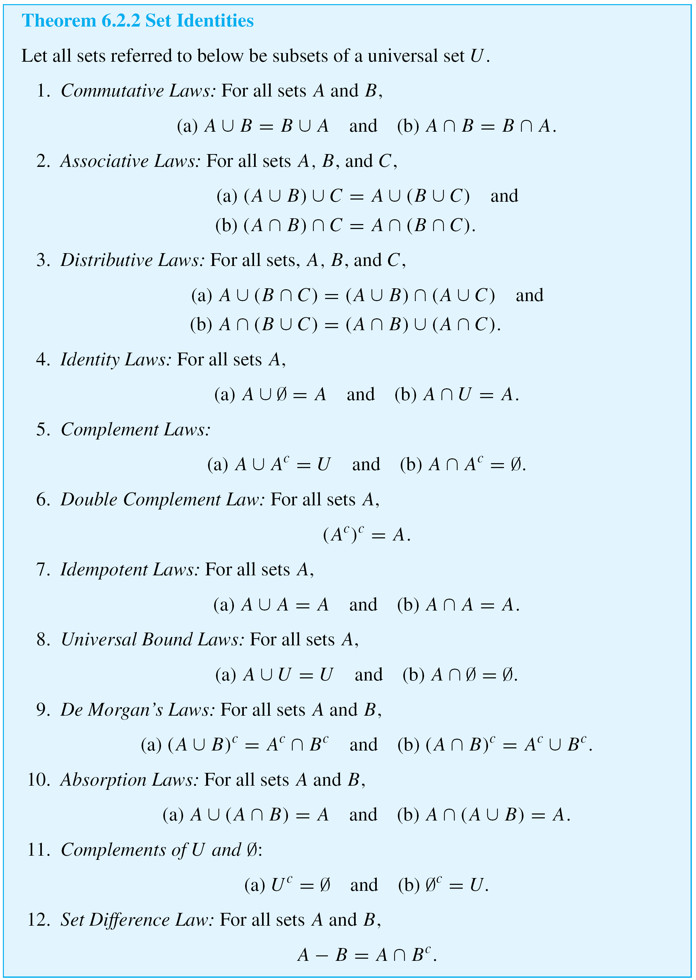
Boolean Algebras, Russell’s Paradox, and the Halting Problem

Slide 7
Boolean Algebras, Russell’s Paradox, and the Halting Problem
cont’d

Slide 8
Boolean Algebras, Russell’s Paradox, and the Halting Problem
If you let ∨ (or) correspond to ∪ (union), ∧ (and) correspond to ∩ (intersection), t (a tautology) correspond to U (a universal set), c (a contradiction) correspond to Ø (the empty set), and ~ (negation) correspond to
^{c} (complementation), then you can see that the structure of the set of statement forms with operations ∨ and ∧ is essentially identical to the structure of the set of subsets of a universal set with operations ∪ and ∩.
In fact, both are special cases of the same general structure, known as a Boolean algebra.

Slide 9
Boolean Algebras, Russell’s Paradox, and the Halting Problem
In this section we show how to derive the various properties associated with a Boolean algebra from a set of just five axioms.

Slide 10
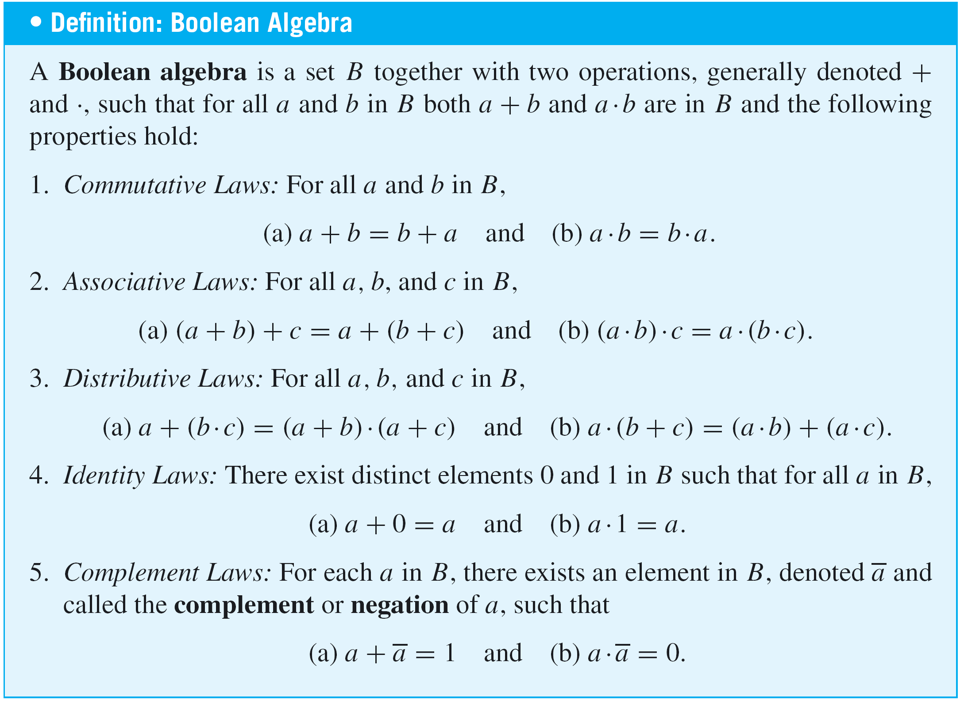
Boolean Algebras, Russell’s Paradox, and the Halting Problem

Slide 11
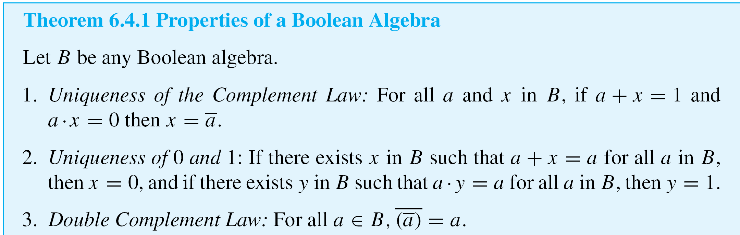
Boolean Algebras, Russell’s Paradox, and the Halting Problem
In any Boolean algebra, the complement of each element is unique, the quantities 0 and 1 are unique, and identities analogous to those in Theorem 2.1.1 and Theorem 6.2.2 can be deduced.

Slide 12
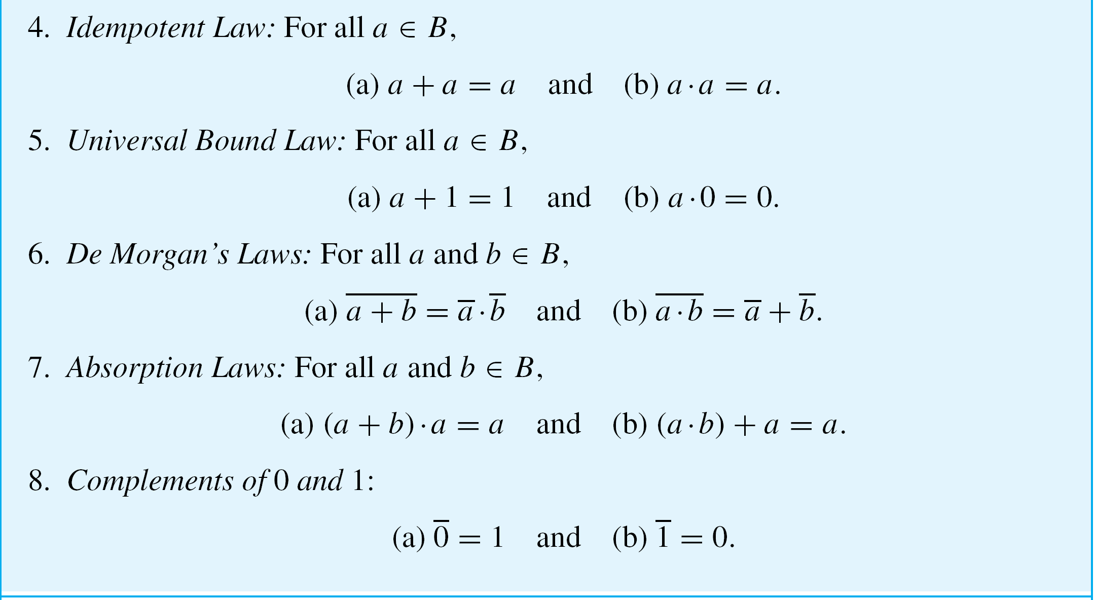
Boolean Algebras, Russell’s Paradox, and the Halting Problem
cont’d

Slide 13
Boolean Algebras, Russell’s Paradox, and the Halting Problem
You may notice that all parts of the definition of a Boolean algebra and most parts of Theorem 6.4.1 contain paired statements. For instance, the distributive laws state that for all a, b, and c in B,
(a) a + (b  c) = (a + b)  (a + c) and
(b) a  (b + c) = (a  b) + (a  c),
and the identity laws state that for all a in B,
(a) a + 0 = a and (b) a  1 = a.

Slide 14
Boolean Algebras, Russell’s Paradox, and the Halting Problem
Note that each of the paired statements can be obtained from the other by interchanging all the + and · signs and interchanging 1 and 0. Such interchanges transform any Boolean identity into its dual identity.
It can be proved that the dual of any Boolean identity is also an identity. This fact is often called the duality principle for a Boolean algebra.

Slide 15


Example 1 – Proof of the Double Complement Law
Prove that for all elements a in a Boolean algebra
Solution:
Start by supposing that B is a Boolean algebra and a is any element of B. The basis for the proof is the uniqueness of the complement law: that each element in B has a unique complement that satisfies certain equations with respect to it.
So if a can be shown to satisfy those equations with respect to , then a must be the complement of .

Slide 16
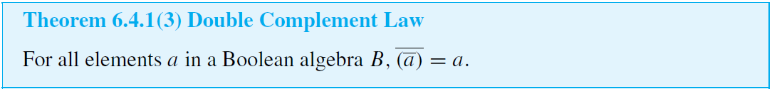
Example 1 – Solution
cont’d
Proof:
Suppose B is a Boolean algebra and a is any element of B. Then
and

Slide 17


Example 1 – Solution
cont’d
Thus a satisfies the two equations with respect to that are satisfied by the complement of . From the fact that the complement of a is unique, we conclude that = a.

Slide 18
Russell’s Paradox

Slide 19
Russell’s Paradox
Russell’s Paradox: Most sets are not elements of themselves. For instance, the set of all integers is not an integer and the set of all horses is not a horse.
However, we can imagine the possibility of a set’s being an element of itself. For instance, the set of all abstract ideas might be considered an abstract idea.
If we are allowed to use any description of a property as the defining property of a set, we can let S be the set of all sets that are not elements of themselves:

Slide 20
Russell’s Paradox
Is S an element of itself? The answer is neither yes nor no.
For if S ∈ S, then S satisfies the defining property for S, and hence S ∉ S. But if S ∉ S, then S is a set such that
S ∉ S and so S satisfies the defining property for S, which implies that S ∈ S.
Thus neither is S ∈ S nor is S ∉ S, which is a contradiction. To help explain his discovery to laypeople, Russell devised a puzzle, the barber puzzle, whose solution exhibits the same logic as his paradox.

Slide 21
Example 3 – The Barber Puzzle
In a certain town there is a male barber who shaves all those men, and only those men, who do not shave themselves.
Question: Does the barber shave himself?
Solution:
Neither yes nor no. If the barber shaves himself, he is a member of the class of men who shave themselves.
But no member of this class is shaved by the barber, and so the barber does not shave himself.

Slide 22
Example 3 – Solution
cont’d
On the other hand, if the barber does not shave himself, he belongs to the class of men who do not shave themselves.
But the barber shaves every man in this class, so the barber does shave himself.

Slide 23
Russell’s Paradox
So let’s accept the fact that the paradox has no easy resolution and see where that thought leads. Since the barber neither shaves himself nor doesn’t shave himself, the sentence “The barber shaves himself” is neither true nor false.
But the sentence arose in a natural way from a description of a situation. If the situation actually existed, then the sentence would have to be true or false.
Thus we are forced to conclude that the situation described in the puzzle simply cannot exist in the world as we know it.

Slide 24

Russell’s Paradox
In a similar way, the conclusion to be drawn from Russell’s paradox itself is that the object S is not a set.
Because if it actually were a set, in the sense of satisfying the general properties of sets that we have been assuming, then it either would be an element of itself or not.
Let U be a universal set and suppose that all sets under discussion are subsets of U. Let

Slide 25
Russell’s Paradox
In Russell’s paradox, both implications
are proved, and the contradictory conclusion
is therefore deduced. In the situation in which all sets under discussion are subsets of U, the implication
S ∈ S → S ∉ S is proved in almost the same way as it is for Russell’s paradox: (Suppose S ∈ S. Then by definition of S, S ⊆ U and S ∉ S. In particular, S ∉ S.)

Slide 26

Russell’s Paradox
On the other hand, from the supposition that S ∉ S we can only deduce that the statement “S ⊆ U and S ∉ S” is false.
By one of De Morgan’s laws, this means that “S U or
S ∈ S.” Since S ∈ S would contradict the supposition that
S ∉ S, we eliminate it and conclude that S U.
In other words, the only conclusion we can draw is that the seeming “definition” of S is faulty—that is, that S is not a set in U.

Slide 27
The Halting Problem

Slide 28
The Halting Problem
If you have some experience programming computers, you know how badly an infinite loop can tie up a computer system.
It would be useful to be able to preprocess a program and its data set by running it through a checking program that determines whether execution of the given program with the given data set would result in an infinite loop.
Can an algorithm for such a program be written?

Slide 29
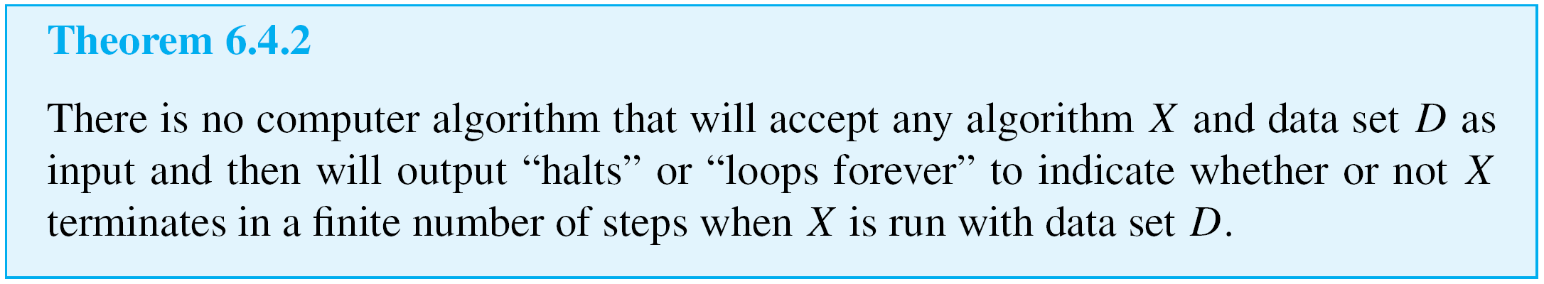
The Halting Problem
In other words, can an algorithm be written that will accept any algorithm X and any data set D as input and will then print “halts” or “loops forever” to indicate whether X terminates in a finite number of steps or loops forever when run with data set D?
In the 1930s, Turing proved that the answer to this question is no.

Slide 30
The Halting Problem
In recent years, the axioms for set theory that guarantee that Russell’s paradox will not arise have been found inadequate to deal with the full range of recursively defined objects in computer science, and a new theory of
“non-well-founded” sets has been developed.
In addition, computer scientists and logicians working on programs to enable computers to process natural language have seen the importance of exploring further the kinds of semantic issues raised by the barber puzzle and are developing new theories of logic to deal with them.

